Slide 1
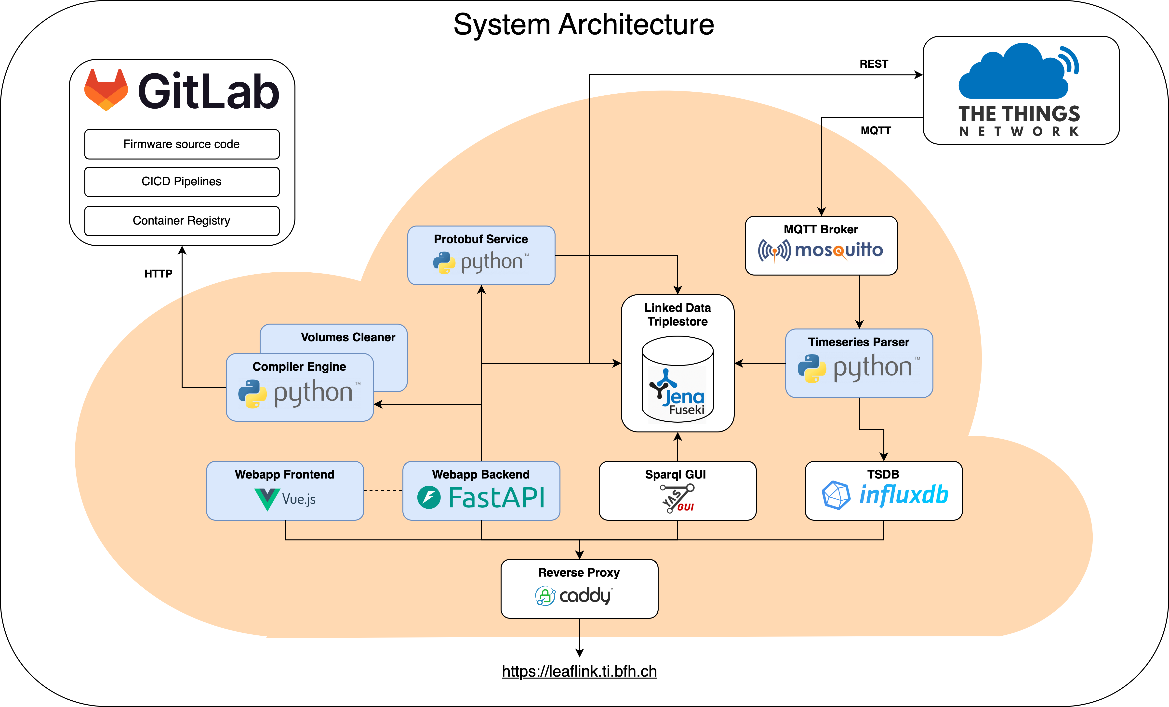
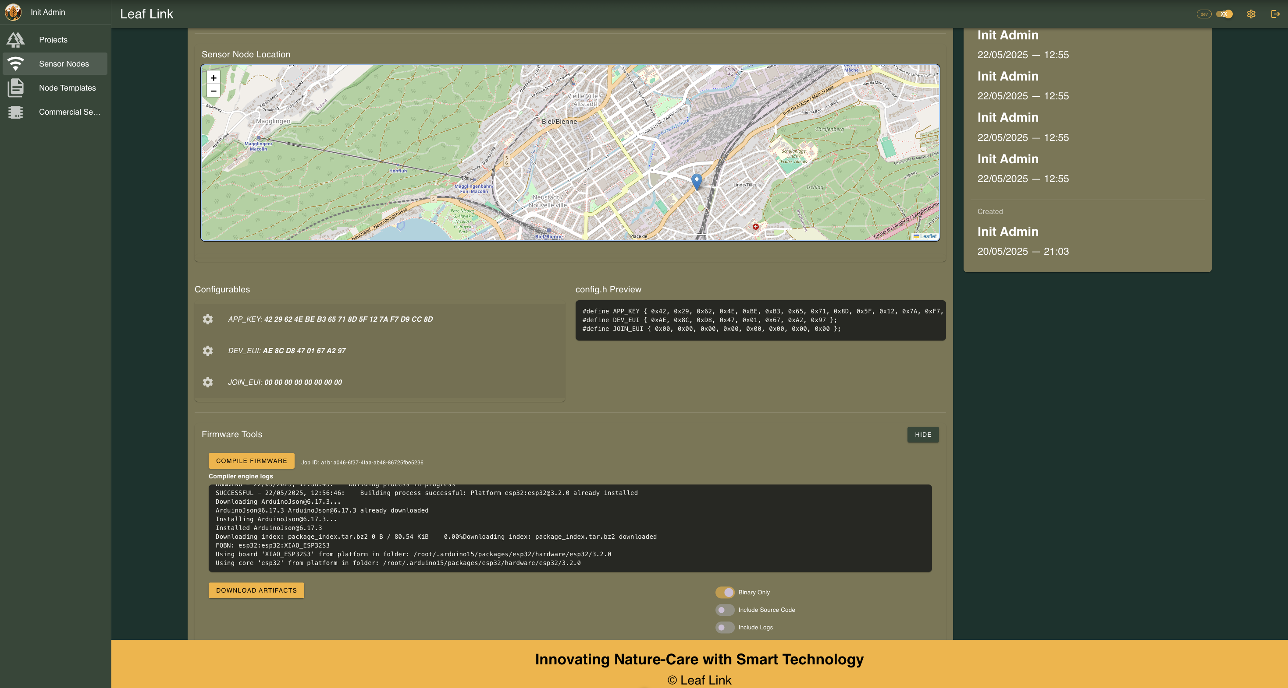
The Idea
Text & Image
The system
Text & Image
The solution
Text & Image
«LeafLink» Infrastructure for Sensor Management
Graduate(s): | Linus Degen Enrico Cirignaco
Professor: | Pascal Mainini
Expert: | Thomas Jäggi
Bachelor Thesis 2025 Degree Programme Computer Science

